Slide 1
Useful information about MS-based metabolomics
2nd UAB Metabolomics National Workshop, June 2-5, 2014
Stephen Barnes, PhD
University of Alabama at Birmingham

Slide 2
Different MS approaches
Gas chromatography-mass spectrometry (GC-MS)
  This was the original method (still used)
  Relies on making stable, volatile derivatives of the metabolites
  Typically limited to masses up to 350-400 Da
Liquid chromatography-mass spectrometry (LC-MS)
  Does not (necessarily) require derivatization
  By convention, masses up to 1500 Da

Slide 3
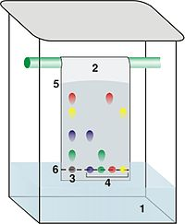
Basis of Chromatography
A moving (mobile) phase passes over an inert, stationary phase
  The compounds differentially interact with the stationary phase and elute at different times
The stationary phase can be paper, silica, coated silica and derivatized silica
The mobile phase can be a gas or a liquid (organic solvent or water)

Slide 4
GC
The stationary phase is a solid coated or chemically bonded with a liquid phase
  These days it is a coating or material bonded onto the interior wall of a capillary tube (usually quartz)
The moving (mobile) phase is a gas
  N₂ or He
  Now H₂
Elution occurs with a stable flow rate and temperature programming

Slide 5
Capillary GC
Packed columns had size limitations due to the pressure drop across the column (5000 plates)
Van Deemter equation:
  Height of theoretical plate (HETP) (lower the better)
  HETP = A + B/u + C*u where u = linear velocity
  The compressibility of a gas means that the linear flow velocity is lower at the top of the column
By using open tubular capillary columns, the pressure drop is minimized and columns up to 100 meters are common (>100,000 plates)

Slide 6
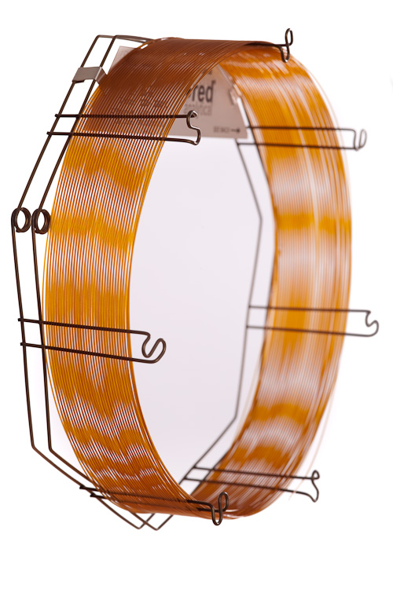
Coated capillary columns
The liquid phase is either applied as a thin film on the inside wall of the quartz capillary, or is chemically bonded (more temperature stable)

Slide 7
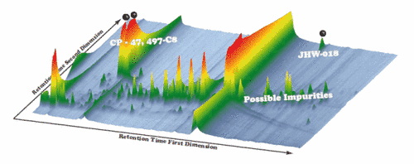
GC-GC
In this approach, fractions from the first GC column are orthogonally analyzed on a second, different GC column
2D-GC x GC reveals hidden peaks buried in major peaks in a 1D separation

Slide 8
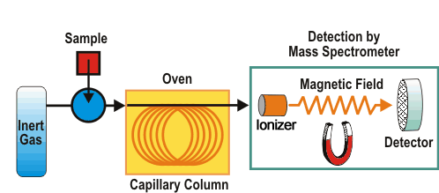
GC-MS
Consists of several steps: sample injection, compound separation, gas phase transfer, mass analysis

Slide 9
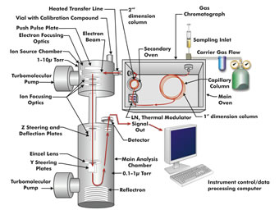
GC x GC-TOF-MS
Compounds emerging from the second column can be ionized and analyzed by time-of-flight MS analysis

Slide 10
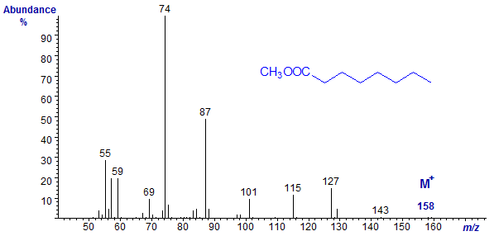
GC-MS
Compounds eluting from the capillary GC are ionized by an electron beam (70 eV)
  Ions have a mass-to-charge ratio (m/z)
  Only rarely is the molecular ion observed, but many fragment ions are in the spectrum

Slide 11
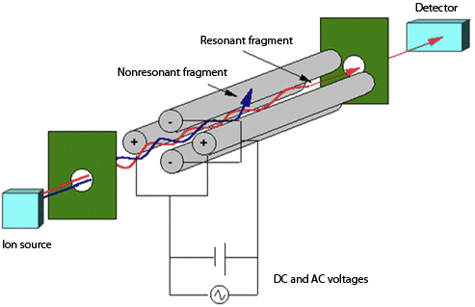
GC-MS mass analyzers
Ions are filtered one at a time (mass window of 0.2-0.7 Da) through a quadrupole mass filter
Robust, but low mass resolution and slow

Slide 12
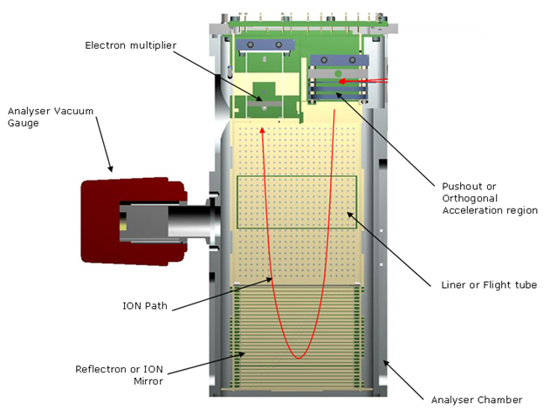
GC-MS TOF analyzer
Note that all the ions reach the detector. The analysis is very fast (< 1 msec) and it has much higher mass resolution (up to 40,000) and mass accuracy (2-3 ppm) than a quadrupole

Slide 13
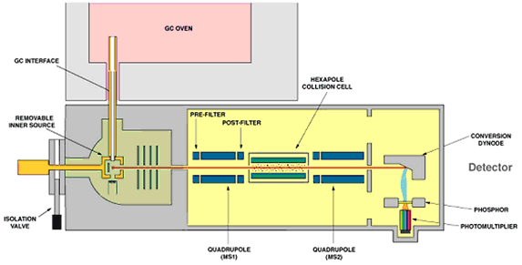
GC-triple quadrupole-MS/MS
Ions selected by the 1st quadrupole are collisionally dissociated and analyzed by the 3rd quadrupole.

Slide 14
Metabolomics and GC-MS
PROS
  Capillary columns can achieve very high chromatographic resolution
  Retention times are reproducible
  Mass spectral libraries are well developed
CONS
  Not all compounds can be analyzed by GC-MS
  Although amino acids, sugars, fatty acids, amines and organic acids can be derivatized, complex polyphenol glycosides and polar lipids are too unstable, even when derivatized, at the temperatures used to elute them

Slide 15
LC
The solid phase is typically silica
  The silica surface can be made to be hydrophobic with attached alkyl groups (reverse-phase), or hydrophilic with attached NH₂ groups (normal phase)
The mobile phase is a liquid
  Gradients of methanol, ethanol, isopropanol, or acetonitrile in water with volatile additives (0.1% formic acid or formic acid, 2-10 mM ammonium acetate or formate)
  Trifluoroacetic acid is not used, nor are Tris or phosphate buffers

Slide 16
LC-MS
The advantage of an effective LC-MS system would be that it would allow thermally unstable compounds, even large ones (such as proteins), to go into the gas phase from liquid solution and into the mass spectrometer
Importantly, the ionization methods used are soft in nature and molecular ions [M+H]⁺ or [M-H]⁻ are easily formed (see later re other molecular ions)
However, there are some compounds that cannot be ionized by LC-MS
  polycyclic aromatic hydrocarbons, alkanes, waxes.

Slide 17
LC-MS interface
The key issue is how to transfer ions from the liquid phase into the gas phase while minimizing the transfer of solvent into the mass spectrometer
  For compounds that can be charged, electrospray ionization (ESI) is the principal method of choice
  Nebulization of the electrical charged droplets more effectively decreases the size of droplets
    This allows all aqueous solvents to be processed by the interface
  Heating the spray further increases sensitivity
    Not used in nanoelectrospray ionization

Slide 18
Electrospray Ionization (ESI)
N₂ curtain gas
nebulizing
gas
sample
solution
Mass
Analyzer
+HV
Atmospheric pressure
Vacuum
+
+
+
+
+
+
+
+
+
+
[M + nH]^{n+}
+
+
+
+
+
+
+
+
1. Solvent evaporation
2. Coulombic repulsion

Slide 19
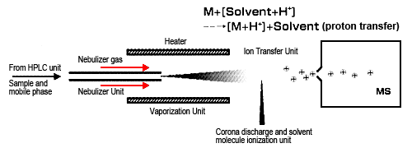
Atmospheric chemical ionization (APCI)
Suitable for compounds that are neutral
A corona discharge needle ionizes air molecules that transfer their energy to the solvent and hence the solutes

Slide 20
Guide to LC-MS flow rates
Type | Column ID | Flow rate | Solvent consumed*
Conventional | 1.0-4.6 mm | 0.050-1.00 ml/min | 72-1440 ml
Capillary | 0.3-1.0 mm | 0.005-0.050 ml/min | 7.2-72 ml
Nano | 0.05-0.20 mm | 100-1000 nl/min | 0.144-1.44 ml
Sensitivity in LC-ESI-MS increases in proportion to the inverse of the flow rate. Therefore, there is value in going to lower flow rates – it also saves money on solvents.

Slide 21
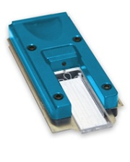
ChipLC versus nanoLC
A nanoLC column is so thin (75 μm i.d.) it has very little thermal capacity – this leads to variable retention times due to temperature fluctuations in the lab
A column etched in a block of silica can be engineered to have greater physical reproducibility and it has far greater thermal capacity. The CHIP can be placed in temperature-controlled chamber – we operate ours at 55ºC – to recover more hydrophobic metabolites

Slide 22
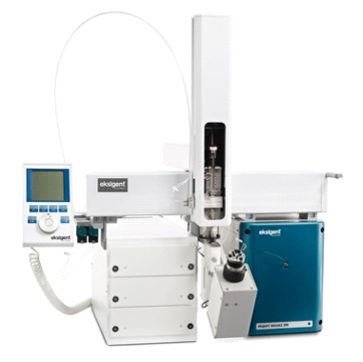
Engineered microflow LC
Chromatography at flow rates of 5-50 μl/min using 0.3-0.5 mm ID columns
Very low dead volumes between the sample injection valve and the ESI interface despite the low flow rate
Enables short, reproducible gradients (1-2 min) or up to a 20 min gradient (for metabolomics) at 5 μl/min

Slide 23
Column phases
Reverse-phase
  C₄, C₅, C₈, C₁₈, phenyl-hexyl-bonded phases
Normal phase
  Bare silica, Cyano and amino-bonded phases
Hydrophilic interaction chromatography
  Bare silica, polyol-bonded phase
Particle sizes
  5, 3, 2.5, 2.2 μm and 1.7 μm (for UPLC)

Slide 24
Mobile phases
Acidic media
  Typically 0.1% formic acid
Neutral media
  1-10 mM ammonium acetate or formate
Alkaline media
  0.1% ammonium hydroxide (but not with C₄-C₁₈ phases)
Solvents (water-miscible)
  Methanol, acetonitrile, isopropanol (for hydrophobic metabolites)

Slide 25
Detector types
Type | Mass range (m/z) | Resolution | Accuracy (ppm) | Time for MSMS (msec)
Quadrupole | 20-3000 | 2,000 | 50 | 1000
TOF | unlimited | 30,000-40,000 | 2-3 | 50 or less
Orbi-trap* | 50-6000 | 80,000-200,000 | 1-3 | 200+
FT-ICR* | 100-1,500 | Up to 1,000,000 | <1 | 1000
*These detectors depend on ion motion and therefore their performance declines as the acquisition time is shortened. Using a 80 msec MSMS acquisition, mass resolution on an Orbi-trap falls to 17,000. The TOF detector is the preferred one for untargeted analysis. The Orbi-trap and FT-ICR instruments are important for follow-up high mass accuracy experiments.

Slide 26
Detector combinations
Each detector can record a MS spectrum
  Not sufficient even with high mass accuracy to identify the metabolite
    100s of metabolites can have the same empirical formula (and identical mass)
Fragmentation of selected ions creates a MSMS spectrum to distinguish isobaric metabolites
  In IDA analysis, molecular ions detected in a quick Hi-Res MS, are “selected” by the quadrupole filter one at a time
  The ion is fragmented and a MSMS spectrum recorded
    TOF instruments can record 20 MSMS spectra per second

Slide 27
Primer for selecting ions for MRM
Peak width (sec) | Cycle time (sec) | Dwell time (msec) | Number of channels
5 | 0.5 | 20 | 25
10 | 1.0 | 20 | 50
5 | 0.5 | 10 | 50
10 | 1.0 | 10 | 100
5 | 0.5 | 5 | 100
10 | 1.0 | 5 | 200
5 | 0.5 | 2 | 250
10 | 1.0 | 2 | 500
The number of channels can be increased by using timed windows

Slide 28
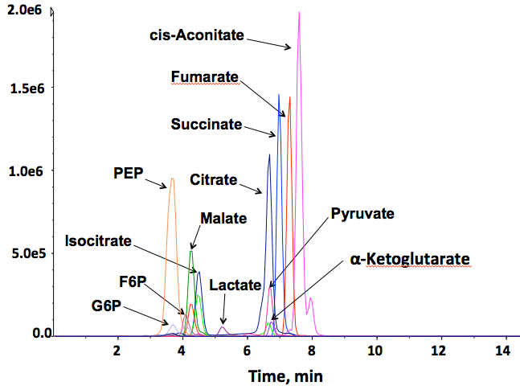
Combined channels for Krebs cycle

